Slide 1
BIG DATA ANALYTICS
CASE STUDIES

Slide 2


Relational vs. Non-Relational Architecture
Relational Non-Relational
Rational
Predictable
Traditional
Agile
Flexible
Modern

Slide 3
Lesson Objectives
At the end of this lesson, students should be able to:
Discuss big data challenges
Gain awareness of big data reference architectures
Apply big data analytics techniques from Case studies
Explain tips for designing big data solutions

Slide 4









Big Data Challenges
UNSTRUCTURED
STRUCTURED
HIGH
MEDIUM LOW
Archives
Docs
Business Apps
Media
Social Networks
Public Web
Complexity
Data Storages
Velocity
Machine Log Data
Variety
Sensor Data
Volume
Archives
Scanned documents, statements, medical records, e-mails etc..
Media
Images, video, audio etc.
Data Storages
RDBMS, NoSQL, Hadoop, file systems etc.
Docs
XLS, PDF, CSV, HTML, JSON etc.
Social Networks
Twitter, Facebook, Google+, LinkedIn etc.
Machine Log Data
Application logs, event logs, server data, CDRs, clickstream data etc.
Business Apps
CRM, ERP systems, HR, project management etc.
Public Web
Wikipedia, news, weather, public finance etc
Sensor Data
Smart electric meters, medical devices, car sensors, road cameras etc.

Slide 5
Big Data Analytics
Traditional Analytics (BI)
vs
Big Data Analytics
Focus on | Descriptive analytics Diagnosis analytics | Predictive analytics Data Science
Data Sets | Limited data sets Cleansed data Simple models | Large scale data sets More types of data Raw data Complex data models
Supports | Causation: what happened, and why? | Correlation: new insight More accurate answers

Slide 6








Big Data Analytics Use Cases
Low Latency Reliability
Real Time Intelligence
Consumers
Intelligent Agents
Volume Performance
Data Quality Self Service
Data Discovery
Business Reporting
Data Scientists/ Analysts
Business Users

Slide 7
Big Data Analytics Reference Architectures
Architecture Drivers:
Reference Architectures:
Volume
Sources
Throughput
Latency
Extensibility
Data Quality
Reliability
Security
Self-Service
Cost
Extended Relational
Non-Relational
Hybrid

Slide 8

















Relational Reference Architecture
Data Sources
Integration
Data Storages
Analytics
Presentation
Structured
ETL
Data Warehouses
Query & Reporting
Web Browsers
Semi- Structured
Messaging
Data Marts
OLAP Cubes
Native Desktop
Unstructured
API/ODBC
Operational Data Stores
Advanced Analytics
Mobile Devices
Replication
Web Services

Slide 9






Extended Relational Reference Architecture
Data Sources
Integration
Data Storages
Analytics
Presentation
Structured
Data Warehouses
Query & Reporting
Web Browsers
ETL
Semi- Structured
Messaging
Data Marts
OLAP Cubes
Native Desktop
Unstructured
API/ODBC
Operational Data Stores
Advanced Analytics
Mobile Devices
Replication
Web Services
Key components affected with Big Data challenges

Slide 10
















Non-Relational Reference Architecture
Data Sources
Integration
Data Storages
Analytics
Presentation
Structured
ETL
NoSQL
Databases
Query & Reporting
Web Browsers
Semi- Structured
Messaging
Distributed File Systems
Map Reduce
Native Desktop
Unstructured
API
Search Engines
Mobile Devices
Advanced Analytics
Web Services
Key components introduced with non-relational movement
10

Slide 11












Extended Relational vs. Non-Relational Architecture
Architecture Drivers | Extended Relational | Non‐Relational
Large data volume
Self‐service (ad‐hoc reporting)
Unstructured data processing
High data model extensibility
High data quality and consistency
Extensive security
Reliability and fault‐tolerance
Low latency (near‐real time)
Low cost
Skills availability

Slide 12








Extended Relational vs. Non-Relational Architecture
Architecture Drivers | Extended Relational | Non‐Relational
Large data volume
Self‐service (ad‐hoc reporting)
Unstructured data processing
High data model extensibility
High data quality and consistency
Extensive security
Reliability and fault‐tolerance
Low latency (near‐real time)
Low cost
Skills availability

Slide 13




Extended Relational vs. Non-Relational Architecture
Architecture Drivers | Extended Relational | Non‐Relational
Large data volume
Self‐service (ad‐hoc reporting)
Unstructured data processing
High data model extensibility
High data quality and consistency
Extensive security
Reliability and fault‐tolerance
Low latency (near‐real time)
Low cost
Skills availability

Slide 14
Relational vs. Non-Relational Architecture
Relational Non-Relational
Rational
Predictable
Traditional
Agile
Flexible
Modern

Slide 15







Big Data Analytics Use Cases
Real Time Intelligence
Consumers
Intelligent Agents
Performance Volume
Data Discovery
Business Reporting
Data Scientists
Business Users

Slide 16





















Data Discovery: Non-Relational Architecture
Data Sources
Integration
Data Storages
Analytics
Presentation
Structured
ETL
NoSQL
Databases
Query & Reporting
Web Browsers
Semi- Structured
Distributed File Systems
Map Reduce
Native Desktop
Messaging
API
Search Engines
Mobile Devices
Unstructured
Advanced Analytics
Web Services

Slide 17




Big Data Analytics Use Cases
Real Time Intelligence
Consumers
Intelligent Agents
Data Quality Self Service
Data Discovery
Business Reporting
Data Scientists
Business Users

Slide 18




















Business Reporting: Hybrid Architecture
Data Sources
Integration
Data Storages
Analytics
Presentation
Structured
ETL
Relational DWH/DM
SQL Query & Reporting
Web Browsers
Semi- Structured
Distributed File Systems
Map Reduce
Native Desktop
Messaging
Unstructured
API
Search Engines
Mobile Devices
Advanced Analytics
Web Services
Extended Relational components
Non-relational components
18

Slide 19


Big Data Analytics Use Cases
Low Latency Reliability
Real Time Intelligence
Consumers
Intelligent Agents
Data Discovery
Business Reporting
Data Scientists
Business Users

Slide 20
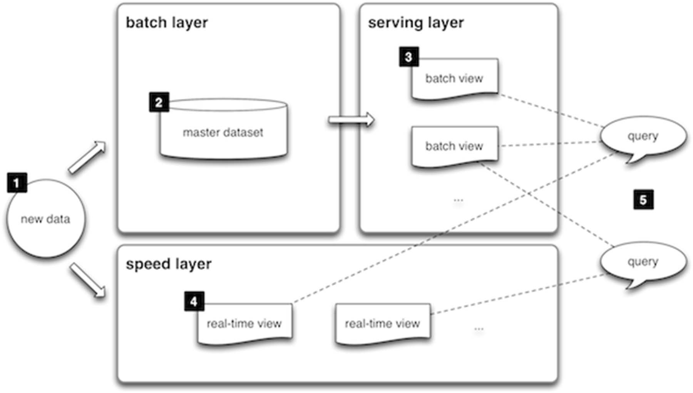
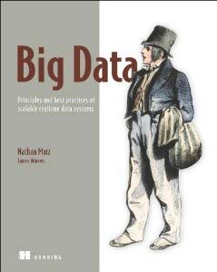
Lambda Architecture
Source:

Slide 21
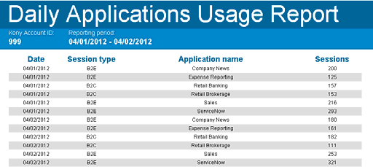

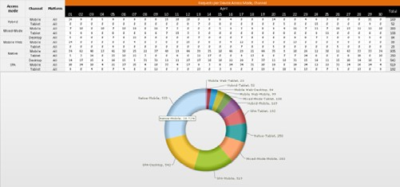

Case Study #1: Usage & Billing Analysis
Business Goals:
Business Area:
Cloud based platform for building, deploying, hosting and managing of mobile applications
Provide visual environment for building custom mobile application
Charge customers based on the platform they are using, number of consumers’ applications etc.

Slide 22


Architectural Decisions
Architecture Drivers:
Volume (> 10 TB)
Sources (Semi-structured - JSON)
Throughput (> 10K/sec)
Latency (2 min)
Extensibility (Custom metrics)
Data Quality (Consistency)
Trade-off:
Reliability (24/7)
Security (Multitenancy)
Self-Service (Ad-Hoc reports)
Cost (The less the better ☺)
Constraints (Public Cloud)
 | Extended Relational | Non-Relational
Extensibility | ‐ | +
Data Quality | + | ‐
Self-Service | + | ‐
Extended Relational Architecture
Extensibility via Pre‐allocated Fields pattern

Slide 23
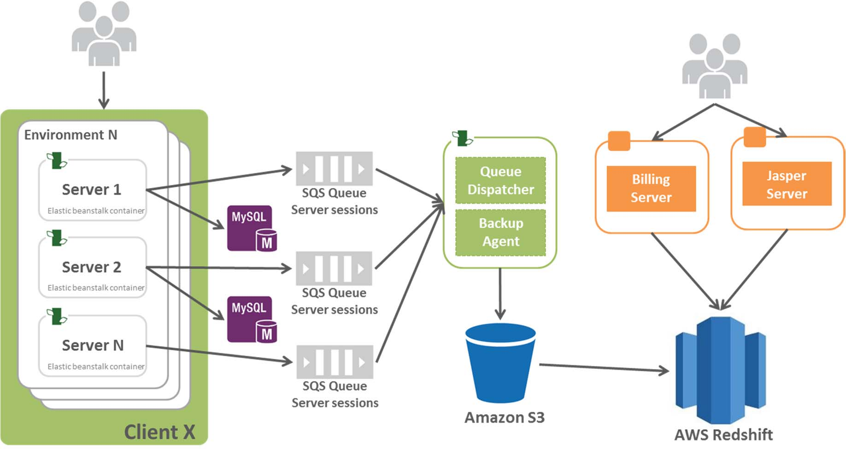
Solution Architecture
Technologies:
Amazon Redshift
Amazon SQS
Amazon S3
Elastic Beanstalk
Jaspersoft BI Professional
Python

Slide 24

Case Study #2: Clickstream for retail website
Business Goals:
Build in-house Analytics Platform for ROI measurement and performance analysis of every product and feature delivered by the e-commerce platform;
Provide the ability to understand how end-users are interacting with service content, products, and features on sites;
Do clickstream analysis;
Perform A/B Testing
Business Area:
Retail. A platform for e-commerce and collecting feedbacks from customers

Slide 25


Architectural Decisions
Architecture Drivers:
Volume (45 TB)
Sources (Semi-structured - JSON)
Throughput (> 20K/sec)
Latency (1 hour)
Extensibility (Custom tags)
Data Quality (Not critical)
Trade-off:
Reliability (24/7)
Security (Multitenancy)
Self-Service (Canned reports, Data science)
Cost (The less the better ☺)
Constraints (Public Cloud)
 | Extended Relational | Non- Relational
Volume/Scalability | +/‐ | +
Throughput | + | +
Self-Service | + | +/‐
Extensibility | ‐ | +
Non‐Relational Architecture
Reporting via Materialized View
pattern

Slide 26
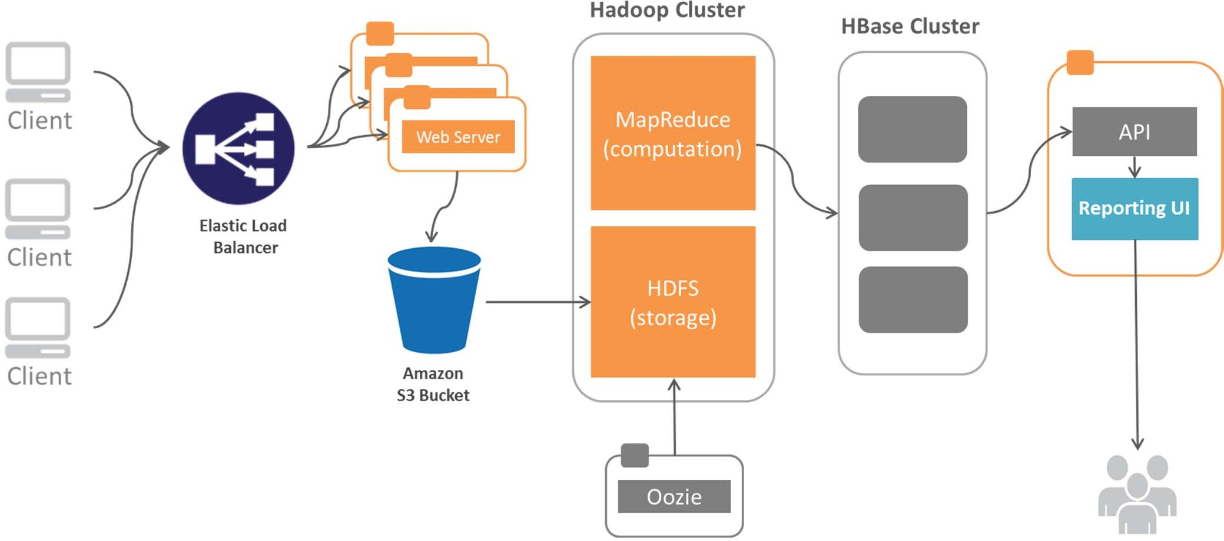
Solution Architecture
Technologies:
Amazon S3
Flume
Hadoop/HDFS, MapReduce
HBase
Oozie
Hive
Node 1
Node 2 Node N

Slide 27
Tips for Designing Big Data Solutions
Understand data users and sources
Discover architecture drivers
Select proper reference architecture
Do trade-off analysis, address cons
Map reference architecture to technology stack
Prototype, re-evaluate architecture
Estimate implementation efforts
Set up devops practices from the very beginning
Advance in solution development through “small wins”
Be ready for changes, big data technologies are evolving rapidly

